Slide 1
Mokum Airways
BA2018
Daphne Molenwijk, Laura Holt, Wouter den Duijn, Joyce Timmer

Slide 2
The Case
6 aircrafts
28 cities
Create one-day flight schedules
20 hour day
Take into account boarding and refuelling times
Profit is the number of passengers times the corresponding kilometres.
Detours

Slide 3
Random Algorithm
Create random route
Add Amsterdam if not start city
Add random city at random index if valid
Add random number of passengers if valid
Stop if no more flying time left
Store the best route

Slide 4
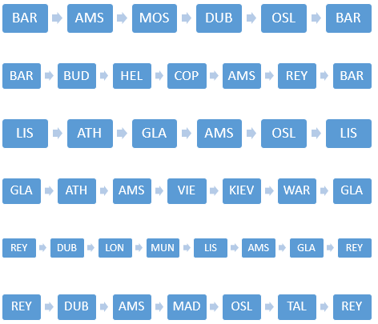
Random Algorithm Results
Schedule:
Profit: €8,761,216.00

Slide 5
Hill Climber Algorithm
Hill Climber Restart
Start with resulting schedule random algorithm
Apply random mutations
Local optimum → Restart with new random route

Slide 6
Mutations
Add/Remove city
Add passengers
Swap cities
Swap detour

Slide 7
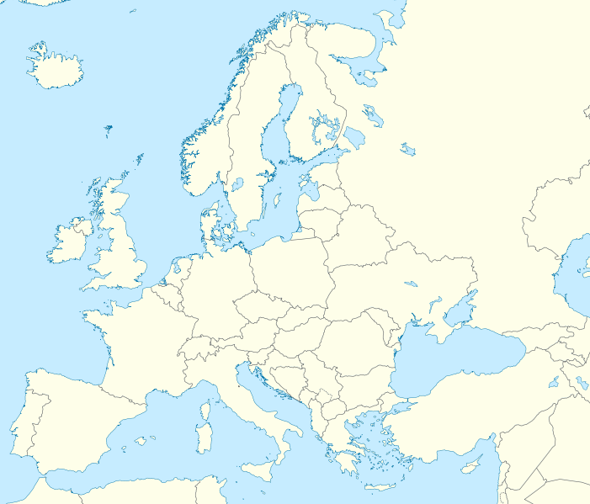
Swap detour
Old:
MAD → ATH 150
MAD → AMS 49
AMS → ATH 49
New:
MAD → ATH 49
MAD → AMS 150
AMS → ATH 150
Both cases have maximum number of passengers on the flights
In the new case passengers pay for more kilometres → higher profit

Slide 8
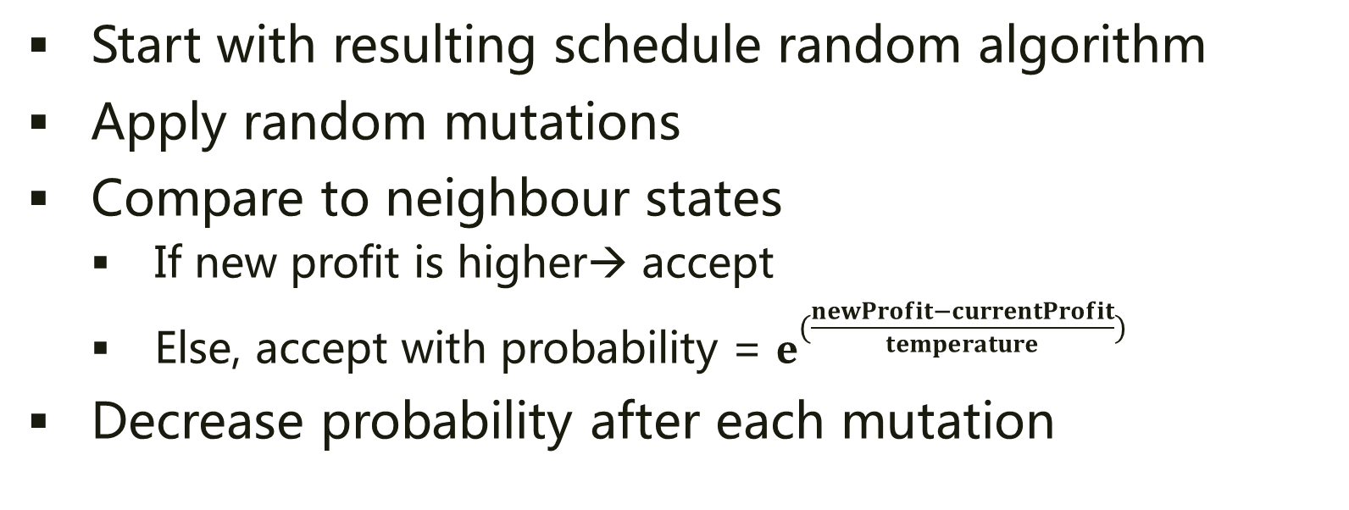
Simulated Annealing
Start with resulting schedule random algorithm
Apply random mutations
Compare to neighbour states
If new profit is higher→ accept
Else, accept with probability = $e^{(\frac{newProfit−currentProfit}{temperature})}$
Decrease probability after each mutation

Slide 9
Current results
Random Algorithm
Profit: €8,761,216.00
Hill Climber Restart:
Profit: €11,331,332.00
Simulated Annealing:
Profit: €9,927,128.00

Slide 10
Current status
Determine proper stop conditions
Visualisation of schedules

